Slide 1


SAP UI5 & FIORI with OData TRAINING using BAS
Anubhav Oberoy
Day – 16

Slide 2

Agenda – Day 16
Understanding the CORS Policy Issue

Slide 3
CORS – Cross Origin Resource Sharing
It is a browser security policy which prevent us connecting to a domain while running web page on a different domain.
Browser
S
https://workspaces-ws-7qbs5-app3.eu10.trial.applicationstudio.cloud.sap/
Proxy
Facebook.com
Google.com
Another Server
http://103.207.171.202:8021/sap/opu/odata/sap/ZOCT_ODATA_SRV/$metadata
https://www.npmjs.com/package/@sap/ux-ui5-tooling

Slide 4
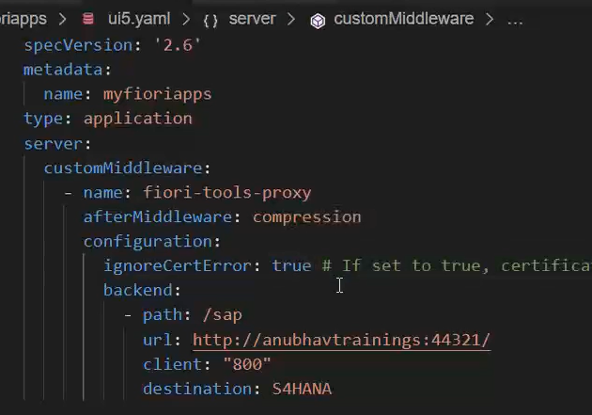
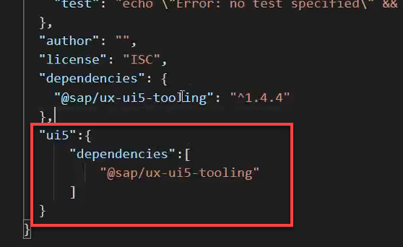
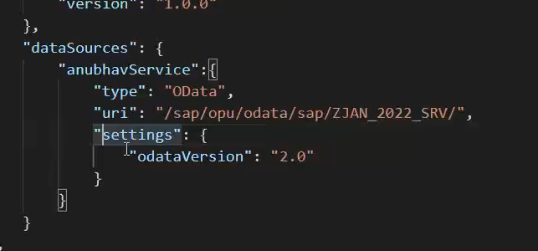
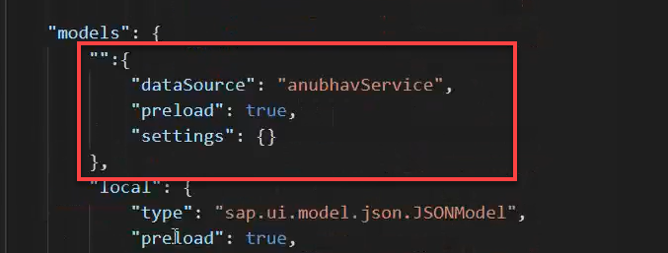
Integrating OData in Fiori App
Before we start OData integration in our fiori project we need have to check that, we have added the package.json and ui5.yaml file in our project, if the we haven’t add then run these commands in the terminal to added these files:
npm init
ui5 init
Now we have the required file in the project, we can proceed the integration.
Go to ui5.yaml file and add the middleware code (given in the link) to the file and save it.
Add the dependency of sap/ux-ui5-tooling to the project using the command: npm install @sap/ux-ui5-tooling
Now add the ui5 section in the package.json file to specify the dependencies related to ui5.
Now go to the manifest.json file we have to add a dataSource under the sap.app section and then create a default model to consume the service in UI.

Slide 5
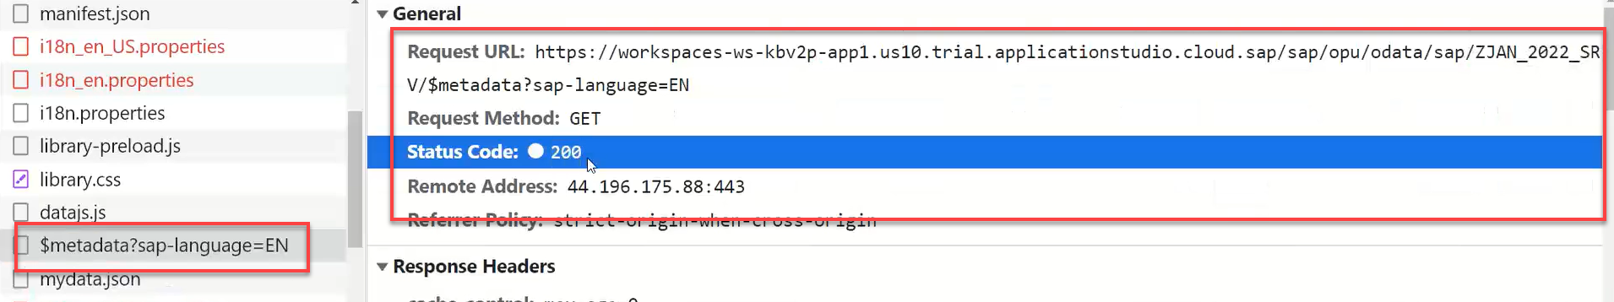
Hands – on: Consume OData service
Follow the steps given in the previous slide to configure the fiori app in BAS to consume the Odata service.
Once the configuration is complete the app will call the metadata of the application which we can check in the Network tab in browser.
Code Link:-
ui5.yaml
package.json
manifest.json

Slide 6
Hands – on: Binding the app with odata
Now to get the data into the application we have to change the binding of the application.
Code Link:-
View1.view.xml
View1.controller.js
View2.view.xml

Slide 7
Title
Content

Slide 8
Title
Content

Slide 9
Title
Content

Slide 10
Title
Content

Slide 11
Title
Content

Slide 12

End of Day 16

Slide 13

Questions

Slide 14

Anubhav Oberoy

Slide 15


We’re committed to empower you to be
Most Desirable Resource
through powerful training solutions.
We build the workforce of the future.
250+
Corporate Clients
30,000+
Learners Trained
25000+
Learners Placed
FREE WEBINARS
Sign up for free webinars with industry experts every fortnight!
Enroll Now!
Contact us today!
https://anubhavtrainings.com/

Slide 16




More from AnubhavTrainings.com

Slide 17
Title
Content

